Slide 1

Multi-Concept Customization of Text-to-Image Diffusion
Git: https://github.com/adobe-research/custom-diffusion

Slide 2
Paper Contents
1
2
3
4
5
Abstract
Introduction
Methods
Experiments
Conclusion

Slide 3
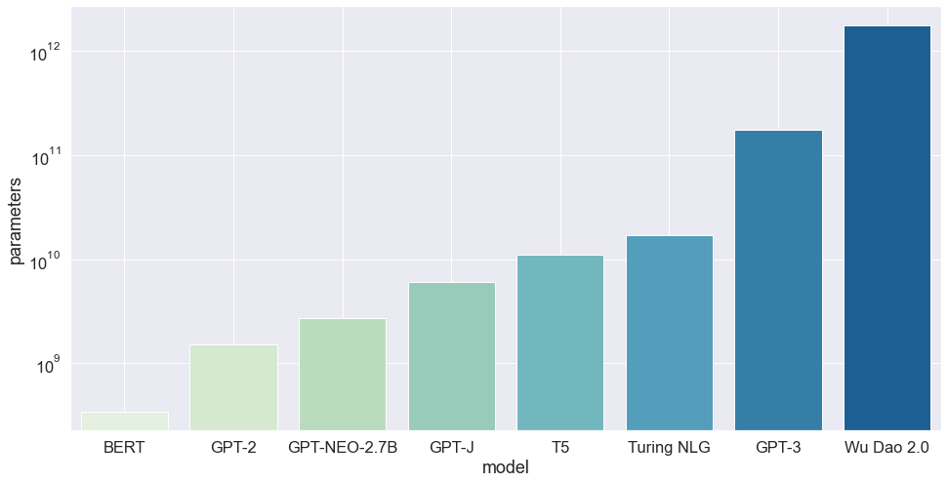
Background

Slide 4
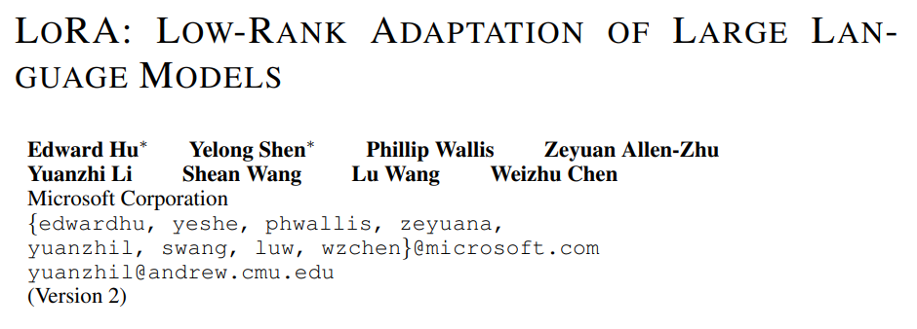
Background
[2021]LoRA

Slide 5
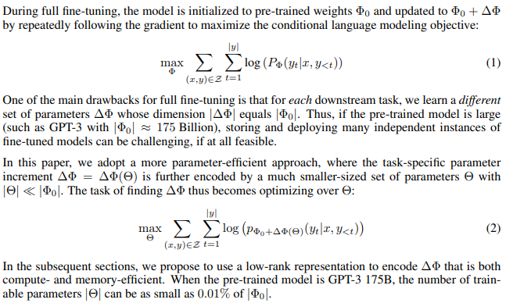
[2021]LoRA
Fully fine-tuning:
Parameter-efficient approach:
Notes:
Over-parameterized model이 실제로는 낮은 low intrinsic dimension에 존재한다는 이전 논문들이 있었다.
따라서, LoRA는 Adaptation중 dense layer의 변화에 대한 rank decomposition matrices를 최적화 한다.
이를 통해 신경망의 일부 dense layer를 간접적으로 훈련시키는 것이 가능.

Slide 6
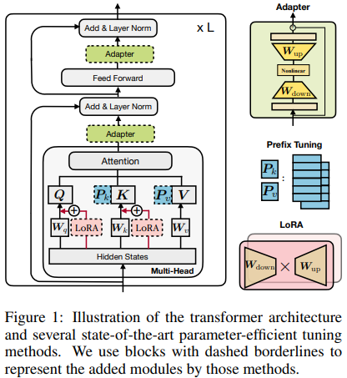
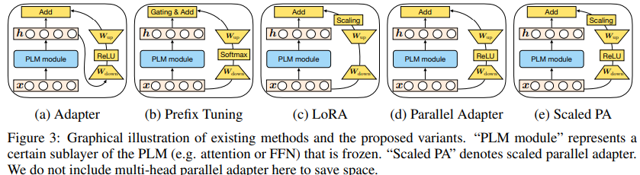
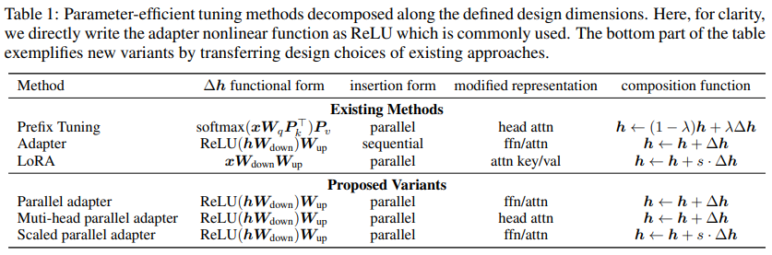
[2021]LoRA
Reference: TOWARDS A UNIFIED VIEW OF PARAMETER-EFFICIENT TRANSFER LEARNING, ICLR 2022
Notes:
TOWARDS A UNIFIED VIEW OF PARAMETER-EFFICIENT TRANSFER LEARNING

Slide 7
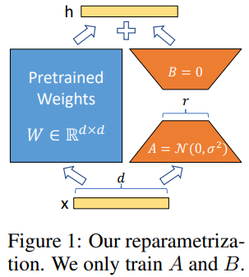
[2021]LoRA
Notes:
TOWARDS A UNIFIED VIEW OF PARAMETER-EFFICIENT TRANSFER LEARNING

Slide 8
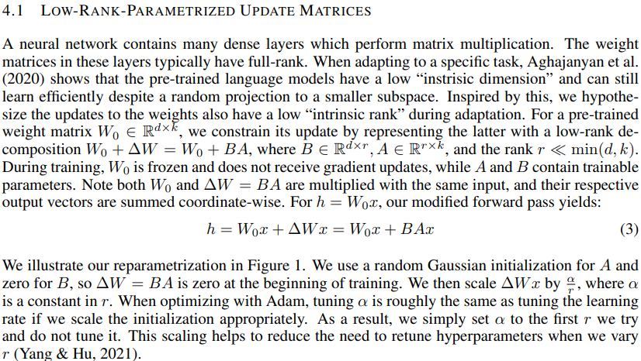
[2021]LoRA
Notes:
Intrinsic Dimensionality Explains the Effectiveness of Language Model Fine-Tuning 에서 Over-parameterized model이 intrinsic rank가 낮다 라고 주장했다. 때문에, W의 변화량 또한 intrinsic rank가 낮다 로 생각.

Slide 9
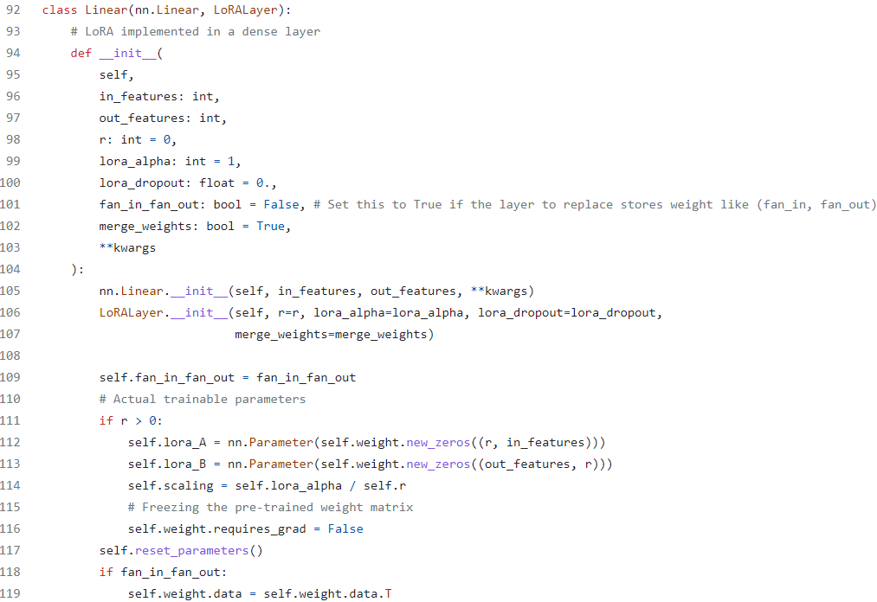
[2021]LoRA
Notes:
TOWARDS A UNIFIED VIEW OF PARAMETER-EFFICIENT TRANSFER LEARNING

Slide 10
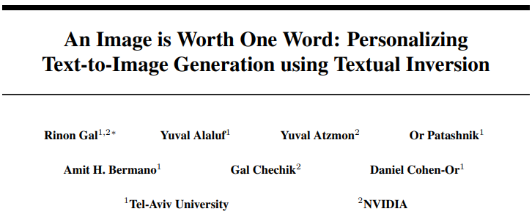
Background
[2022]Textual Inversion

Slide 11
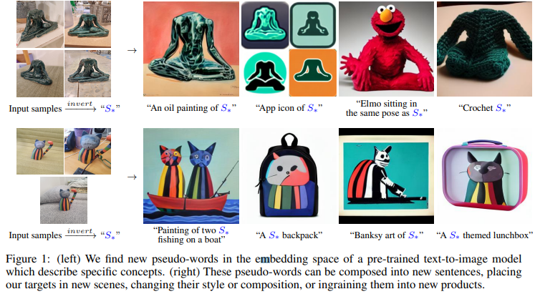
[2022]Textual Inversion

Slide 12
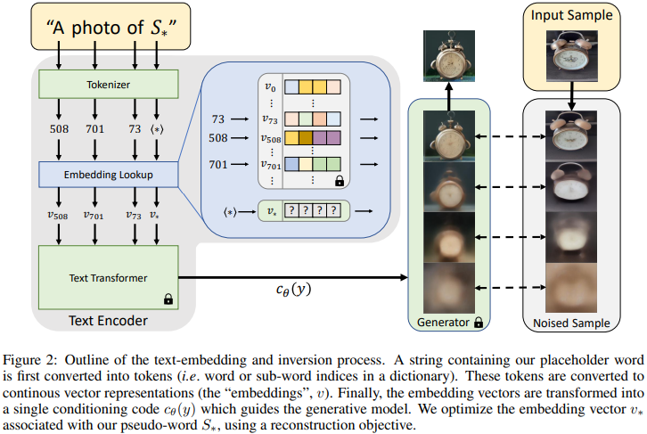
[2022]Textual Inversion

Slide 13
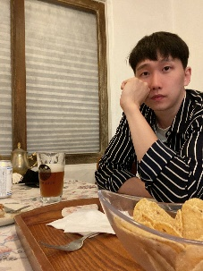
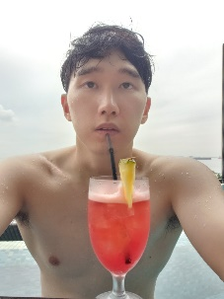
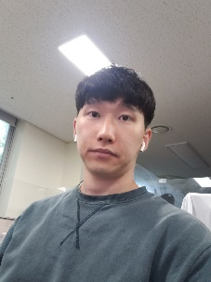
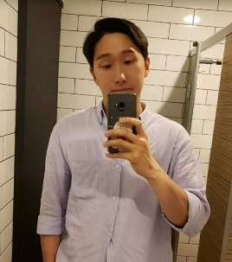
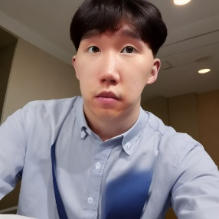
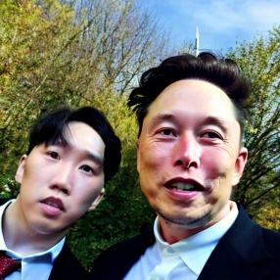
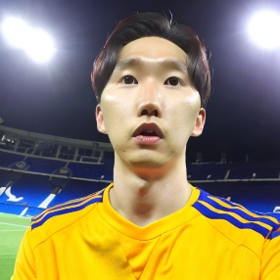
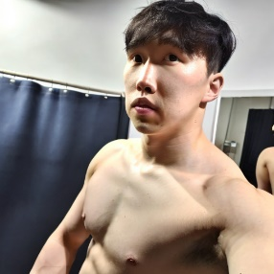
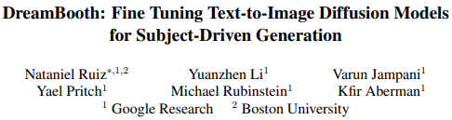
Background
[2022]DreamBooth

Slide 14
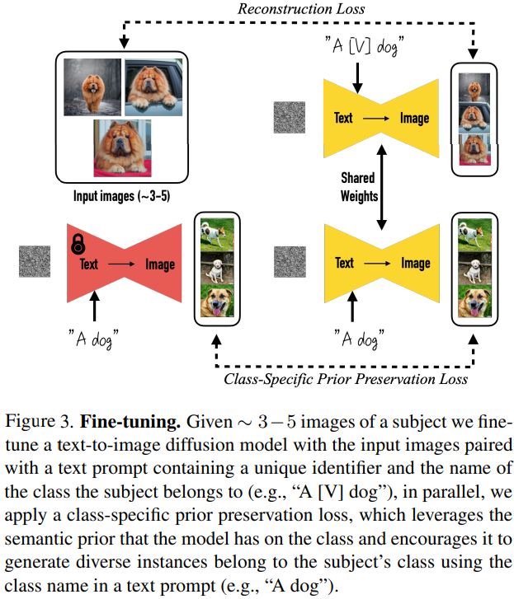
[2022]DreamBooth

Slide 15
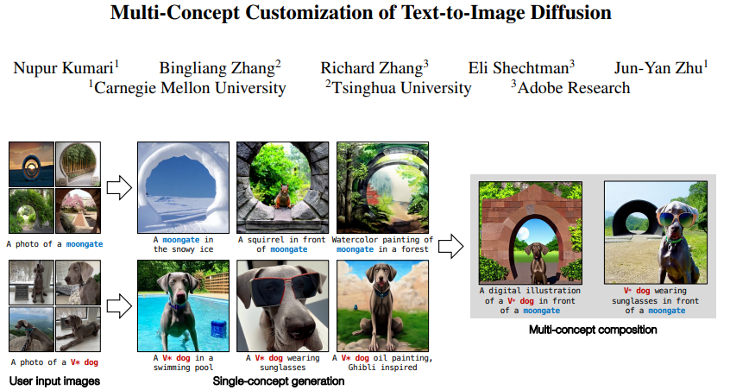

Slide 16
Abstract
While generative models produce high-quality images of concepts learned from a large-scale database, a user often wishes to synthesize instantiations of their own concepts (for example, their family, pets, or items).
Can we teach a model to quickly acquire a new concept, given a few examples? Furthermore, can we compose multiple new concepts together?
We propose Custom Diffusion, an efficient method for augmenting existing text-to-image models. We find that only optimizing a few parameters in the text-to-image conditioning mechanism is sufficiently powerful to represent new concepts while enabling fast tuning (∼ 6 minutes).
Additionally, we can jointly train for multiple concepts or combine multiple fine-tuned models into one via closed-form constrained optimization.
Our fine-tuned model generates variations of multiple, new concepts and seamlessly composes them with existing concepts in novel settings.
Our method outperforms several baselines and concurrent works, regarding both qualitative and quantitative evaluations, while being memory and computationally efficient.

Slide 17
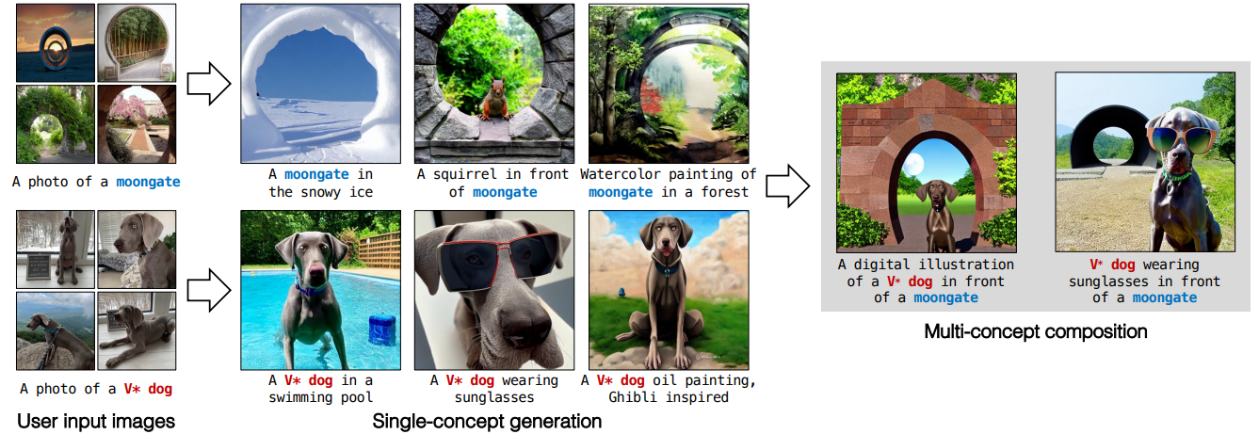
Introduction
Recent text-to-image models revolutionize image generation. Thus, users can create diverse, high-quality images with text prompts.
However, despite the diverse, general capability of such models, users often wish to synthesize specific concepts from their own personal lives (e.g., loved ones, personal items). → Need for model customization arises
Challenges: model forgetting/changing existing concepts, overfitting, compositional fine-tuning.
Compositional fine-tuning: learning and composing multiple new concepts together.
Notes:
However, despite the diverse, general capability of such models, users often wish to synthesize specific concepts from their own personal lives

Slide 18
Introduction
In this work,
Propose Custom Diffusion fine-tuning technique for text-to-image models.
Computationally and memory efficient method.
Targets small subset of model weights in cross-attention layers (key and value mapping from text to latent features).
Prevents model forgetting using real images, similar captions.
Augmentation during fine-tuning for faster convergence, better results.
Supports injecting multiple concepts simultaneously or separately.
Built on Stable Diffusion, tested on various datasets, as few as four images.
Outperforms concurrent works for single concept addition and composing multiple concepts.
Requires only 3% of model weights and faster fine-tuning time (2-4x).

Slide 19
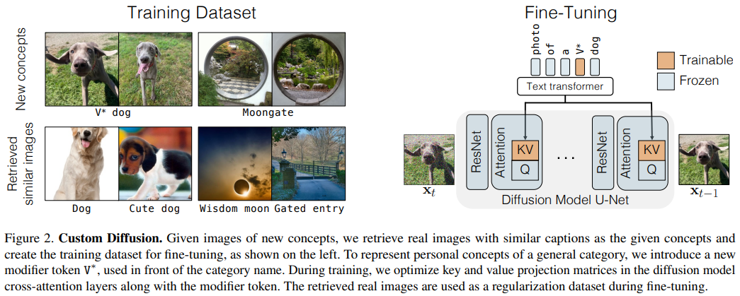
Methods
Notes:
These are compiled of s target words across all N concepts, with all captions for each concept flattened out and concatenated

Slide 20
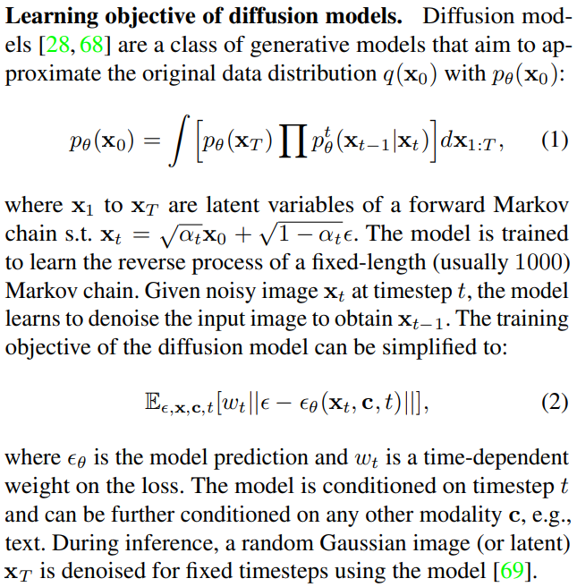
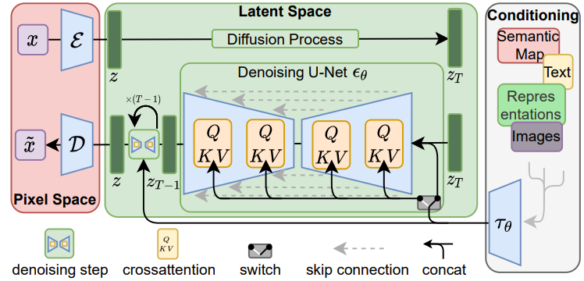
Methods
Learning objective of diffusion models.
Naive fine-tuning: update all layers, risks inefficiency and overfitting.
Goal: identify minimal set of weights for efficient fine-tuning.

Slide 21
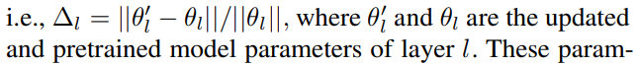
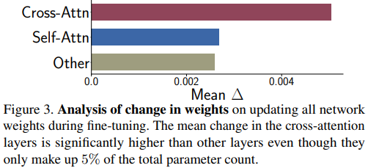
Methods
Rate of change of weights.
Analyze change in parameters for each layer in finetuned model.
Parameters from three layer types: cross-attention, self-attention, and others (e.g., convolutional blocks, normalization).
Cross-attention layer parameters have higher ∆, crucial for fine-tuning.
Cross-attention layers only 5% of total parameter count, suggesting significant role.
Notes:
Following Li et al. [39], we analyze the change in parameters for each layer in the finetuned model on the target dataset with the loss in Eqn. 2, i.e., ∆l = ||θ 0 l − θl ||/||θl ||, where θ 0 l and θl are the updated and pretrained model parameters of layer l. These parameters come from three types of layers – (1) cross-attention (between the text and image), (2) self-attention (within the image itself), and (3) the rest of the parameters, including convolutional blocks and normalization layers in the diffusion model U-Net. Figure 3 shows the mean ∆l for the three categories when the model is fine-tuned on “moongate” images. We observe similar plots for other datasets. As we see, the cross-attention layer parameters have relatively higher ∆ compared to the rest of the parameters. Moreover, crossattention layers are only 5% of the total parameter count in the model. This suggests it plays a significant role during fine-tuning, and we leverage that in our method.

Slide 22
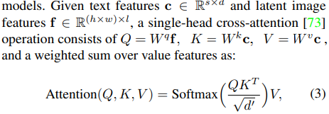
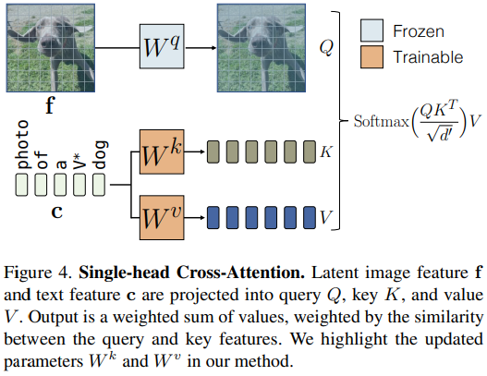
Methods
Model fine-tuning.
Cross-attention block modifies latent features based on condition features (e.g., text).
The task of fine-tuning aims at updating the mapping from given text to image distribution, and the text features are only input to Wk and Wv projection matrix in the cross-attention block (i.e. text-to-image distribution mapping).
Therefore, we propose to only update Wk and Wv parameters of the diffusion model during the fine-tuning process.
As shown in our experiments, this is sufficient to update the model with a new text-image paired concept.
Figure 4 shows an instance of the cross-attention layer and the trainable parameters.
Notes:
Cross-attention block modifies the latent features of the network according to the condition features, i.e., text features in the case of text-to-image diffusion models. Given text features c ∈ R s×d and latent image features f ∈ R (h×w)×l , a single-head cross-attention [73] operation consists of Q = Wq f, K = Wkc, V = Wvc , and a weighted sum over value features as:
Attention(Q, K, V ) = SoftmaxQKT √ d 0 V, (3)
where Wq , Wk , and Wv map the inputs to a query, key, and value feature, respectively, and d 0 is the output dimension of key and query features.
The latent feature is then updated with the attention block output. The task of fine-tuning aims at updating the mapping from given text to image distribution, and the text features are only input to Wk and Wv projection matrix in the cross-attention block. Therefore, we propose to only update Wk and Wv parameters of the diffusion model during the fine-tuning process. As shown in our experiments, this is sufficient to update the model with a new text-image paired concept. Figure 4 shows an instance of the cross-attention layer and the trainable parameters.

Slide 23
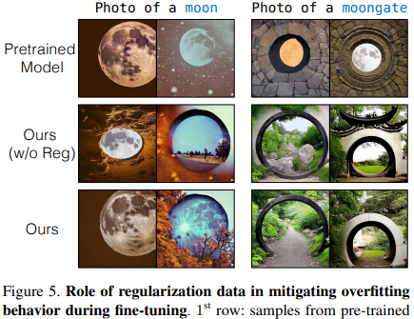
Methods
Text encoding
Require text caption for target concept images.
Use existing description (e.g., moongate) or introduce new modifier token (e.g., V* dog) for unique instances.
Initialize V* with rare token embedding, optimize with cross-attention parameters.
Example caption: "photo of a V* dog.“
Regularization dataset
Fine-tuning can lead to language drift, model forgets associations.
Regularization needed to prevent leaks and maintain existing concepts.
Select 200 regularization images with similar captions to target text prompt.
Use threshold of 0.85 similarity in CLIP text encoder feature space.
Notes:
For example, training on “moongate” will lead to the model forgetting the association of “moon” and “gate” with their previously trained visual concepts, as shown in Figure 5.
Similarly, training on a personalized concept of V ∗ tortoise plushy can leak, causing all examples with plushy to produce the specific target images.

Slide 24
Methods
Joint training on multiple concepts.
Joint training for multiple concepts by combining individual concept datasets.
Use different modifier tokens V_{i}* initialized with different rarely-occurring tokens for target concepts.
Initialize with rarely-occurring tokens, optimize with cross-attention key and value matrices.
Better results for composing two concepts compared to methods that fine-tune all weights (e.g., DreamBooth). → Figure. 7
Notes:
Joint training on multiple concepts. For fine-tuning with multiple concepts, we combine the training datasets for each individual concept and train them jointly with our method. To denote the target concepts, we use different modifier tokens, V ∗ i , initialized with different rarely-occurring tokens and optimize them along with cross-attention key and value matrices for each layer. As shown in Figure 7, restricting the weight update to cross-attention key and value parameters leads to significantly better results for composing two concepts compared to methods like DreamBooth, which fine-tune all the weights.

Slide 25
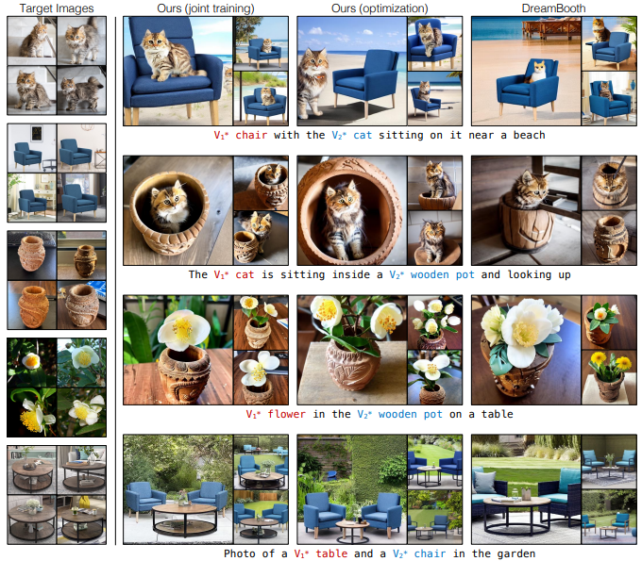
Methods
Figure 7. Multi-concept fine-tuning results.
First row: our method has higher visual similarity with the personal cat and chair images shown in the first column while following the text condition.
Second row: DreamBooth omits the cat in 3 out of 4 images, whereas our method generates both cats and wooden pots.
Third row: our method generates the target flower in the wooden pot while maintaining the visual similarity to the target images.
Fourth row: generating the target table and chair together in a garden.
For all settings, our optimization-based approach and joint training perform better than DreamBooth, and joint training performs better than the optimization-based method.
Notes:
First row: our method has higher visual similarity with the personal cat and chair images shown in the first column while following the text condition. Second row: DreamBooth omits the cat in 3 out of 4 images, whereas our method generates both cats and wooden pots. Third row: our method generates the target flower in the wooden pot while maintaining the visual similarity to the target images. Fourth row: generating the target table and chair together in a garden. For all settings, our optimization-based approach and joint training perform better than DreamBooth, and joint training performs better than the optimization-based method.

Slide 26
Methods
Constrained optimization to merge concepts.
Method updates key and value projection matrices for text features.
Merges matrices to allow generation with multiple fine-tuned concepts.
Composition objective formulated as constrained least squares problem.
Closed-form solution using method of Lagrange multipliers.
Faster than joint training, coherent generation of two new concepts in single scene.
Notes:
As our method only updates the key and value projection matrices corresponding to the text features, we can subsequently merge them to allow generation with multiple fine-tuned concepts. Let set {Wk 0,l, Wv 0,l} L l=1 represent the key and value matrices for all L cross-attention layers in the pretrained model and {Wk n,l, Wv n,l} L l=1 represent the corresponding updated matrices for added concept n ∈ {1 · · · N}. As our subsequent optimization applies to all layers and key-value matrices, we will omit superscripts {k, v} and layer l for notational clarity. We formulate the composition objective as the following constrained least squares problem: Wˆ = arg min W ||W C> reg−W0C > reg||F s.t. W C> = V, where C = [c1 · · · cN ] > and V = [W1c > 1 · · · WN c > N ] >. (4) Here, C ∈ R s×d is the text features of dimension d. These are compiled of s target words across all N concepts, with all captions for each concept flattened out and concatenated. Similarly, Creg ∈ R sreg×d consists of text features of ∼ 1000 randomly sampled captions for regularization. Intuitively, the above formulation aims to update the matrices in the original model, such that the words in target captions in C are mapped consistently to the values obtained from finetuned concept matrices. The above objective can be solved in closed form, assuming Creg is non-degenerate and the solution exists, by using the method of Lagrange multipliers [8]: Wˆ = W0 + v >d, where d = C(C > regCreg) −1 and v > = (V − W0C >)(dC >) −1 . (5) We show full derivation in the Appendix A. Compared to joint training, our optimization-based method is faster (∼ 2 seconds) if each individual fine-tuned model exists. Our proposed methods lead to the coherent generation of two new concepts in a single scene, as shown in Section 4.2.

Slide 27
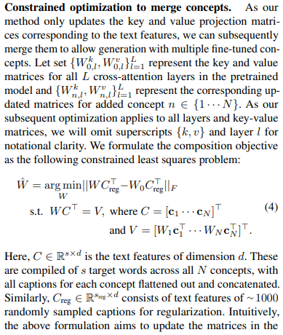
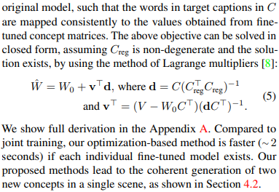
Methods
Constrained optimization to merge concepts.
Notes:
As our method only updates the key and value projection matrices corresponding to the text features, we can subsequently merge them to allow generation with multiple fine-tuned concepts. Let set {Wk 0,l, Wv 0,l} L l=1 represent the key and value matrices for all L cross-attention layers in the pretrained model and {Wk n,l, Wv n,l} L l=1 represent the corresponding updated matrices for added concept n ∈ {1 · · · N}. As our subsequent optimization applies to all layers and key-value matrices, we will omit superscripts {k, v} and layer l for notational clarity. We formulate the composition objective as the following constrained least squares problem: Wˆ = arg min W ||W C> reg−W0C > reg||F s.t. W C> = V, where C = [c1 · · · cN ] > and V = [W1c > 1 · · · WN c > N ] >. (4) Here, C ∈ R s×d is the text features of dimension d. These are compiled of s target words across all N concepts, with all captions for each concept flattened out and concatenated. Similarly, Creg ∈ R sreg×d consists of text features of ∼ 1000 randomly sampled captions for regularization. Intuitively, the above formulation aims to update the matrices in the original model, such that the words in target captions in C are mapped consistently to the values obtained from finetuned concept matrices. The above objective can be solved in closed form, assuming Creg is non-degenerate and the solution exists, by using the method of Lagrange multipliers [8]: Wˆ = W0 + v >d, where d = C(C > regCreg) −1 and v > = (V − W0C >)(dC >) −1 . (5) We show full derivation in the Appendix A. Compared to joint training, our optimization-based method is faster (∼ 2 seconds) if each individual fine-tuned model exists. Our proposed methods lead to the coherent generation of two new concepts in a single scene, as shown in Section 4.2.

Slide 28
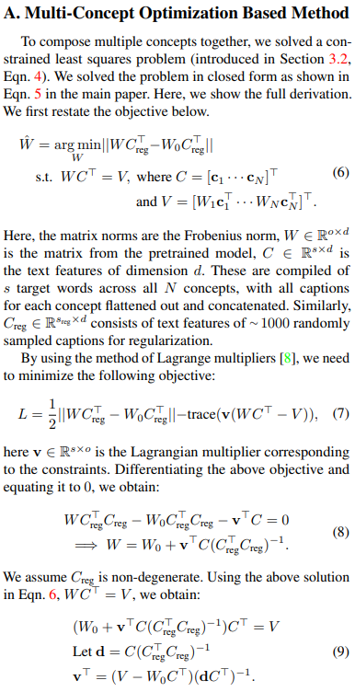
Methods
Constrained optimization to merge concepts.
Notes:
As our method only updates the key and value projection matrices corresponding to the text features, we can subsequently merge them to allow generation with multiple fine-tuned concepts. Let set {Wk 0,l, Wv 0,l} L l=1 represent the key and value matrices for all L cross-attention layers in the pretrained model and {Wk n,l, Wv n,l} L l=1 represent the corresponding updated matrices for added concept n ∈ {1 · · · N}. As our subsequent optimization applies to all layers and key-value matrices, we will omit superscripts {k, v} and layer l for notational clarity. We formulate the composition objective as the following constrained least squares problem: Wˆ = arg min W ||W C> reg−W0C > reg||F s.t. W C> = V, where C = [c1 · · · cN ] > and V = [W1c > 1 · · · WN c > N ] >. (4) Here, C ∈ R s×d is the text features of dimension d. These are compiled of s target words across all N concepts, with all captions for each concept flattened out and concatenated. Similarly, Creg ∈ R sreg×d consists of text features of ∼ 1000 randomly sampled captions for regularization. Intuitively, the above formulation aims to update the matrices in the original model, such that the words in target captions in C are mapped consistently to the values obtained from finetuned concept matrices. The above objective can be solved in closed form, assuming Creg is non-degenerate and the solution exists, by using the method of Lagrange multipliers [8]: Wˆ = W0 + v >d, where d = C(C > regCreg) −1 and v > = (V − W0C >)(dC >) −1 . (5) We show full derivation in the Appendix A. Compared to joint training, our optimization-based method is faster (∼ 2 seconds) if each individual fine-tuned model exists. Our proposed methods lead to the coherent generation of two new concepts in a single scene, as shown in Section 4.2.

Slide 29
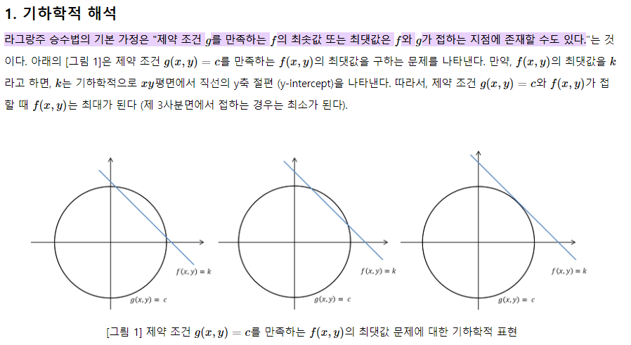
Lagrange multiplier, KKT (Karush-Kuhn-Tucker)
라그랑주 승수법 (Lagrange multiplier method)은 프랑스의 수학자 조세프루이 라그랑주 (Joseph-Louis Lagrange)가 제약 조건이 있는 최적화 문제를 풀기 위해 고안한 방법이다.
라그랑주 승수법은 어떠한 문제의 최적점을 찾는 것이 아니라, 최적점이 되기 위한 조건을 찾는 방법이다. 즉, 최적해의 필요조건을 찾는 방법이다.

Slide 30
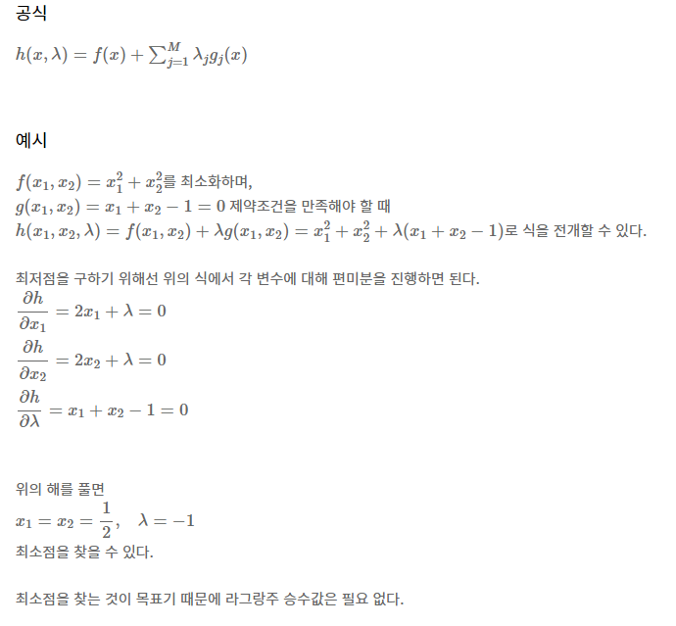
Lagrange multiplier, KKT (Karush-Kuhn-Tucker)

Slide 31
Abstract & Conclusion
Training details.
Training for 250 steps (single-concept) or 500 steps (two-concept joint training).
Batch size: 8; Learning rate: 8×10⁻⁵.
During training, we also randomly resize only the target images from 0.4−1.4× and append the prompt “very small”, “far away” or “zoomed in”, “close up” accordingly to the text prompt based on resize ratio.
Backpropagate loss on valid regions → cross-attention layer.
This leads to faster convergence and improved results.
Notes:
We only backpropagate the loss on valid regions

Slide 32
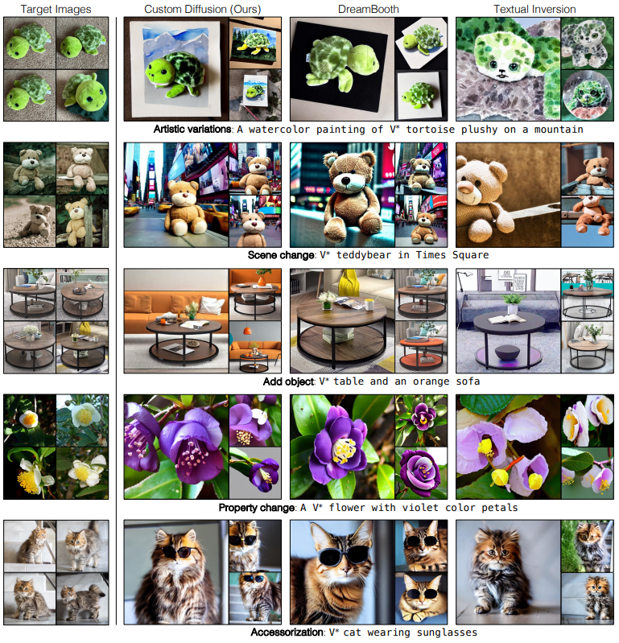
Experiments
Single-Concept Fine-tuning Results
Notes:
We evaluate on 20 text prompts and 50 samples per prompt for each dataset, resulting in a total of 1000 generated images

Slide 33
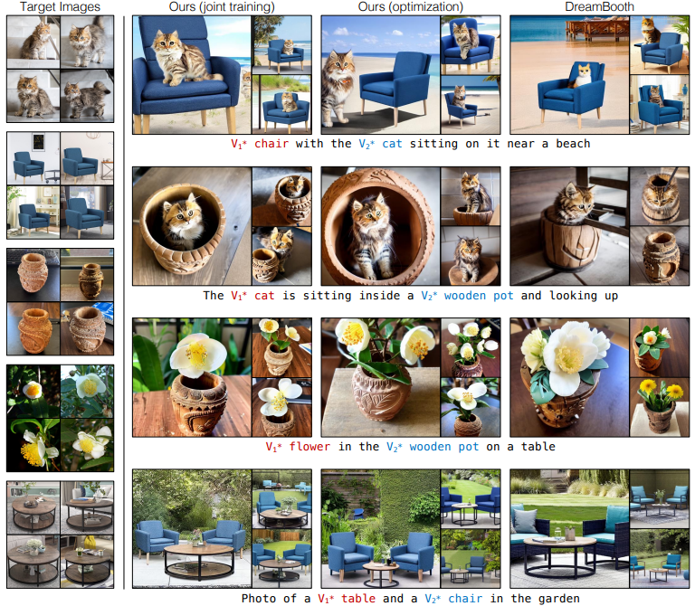
Experiments
Multiple-Concept Fine-tuning Results
Notes:
(1) Moongate + Dog, (2) Cat + Chair, (3) Wooden Pot + Cat, (4) Wooden Pot + flower, and (5) Table + Chair.

Slide 34
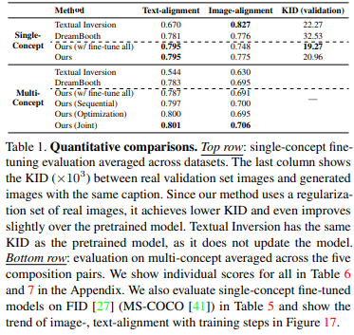
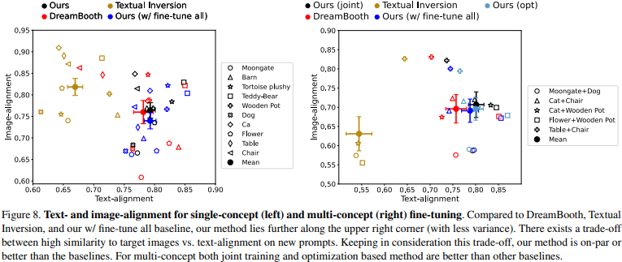
Experiments
Single- and Multiple-Concept Fine-tuning Results

Slide 35
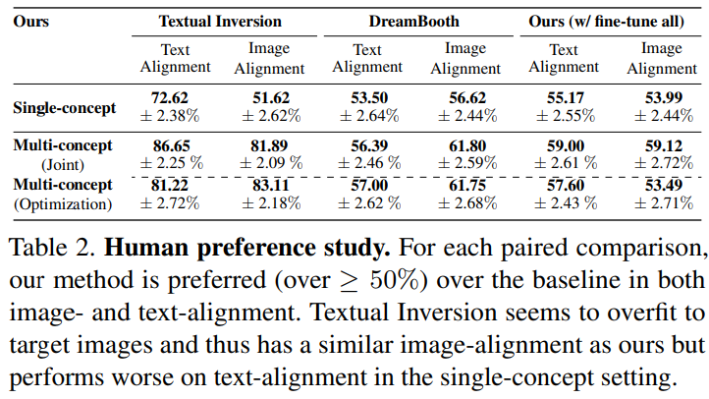
Experiments
Human Preference Study
Human preference study using Amazon Mechanical Turk.
Paired test comparing: DreamBooth, Textual Inversion, and Ours (w/ fine-tune all).
Text-alignment: Assess image consistency with text prompt.
Image-alignment: Assess how well image represents objects in target images.
800 responses collected for each questionnaire.
Importance of updating only cross-attention parameters demonstrated.
Notes:
We perform the human preference study using Amazon Mechanical Turk. We do a paired test of our method with DreamBooth, Textual Inversion, and Ours (w/ fine-tune all). For text-alignment, we show the two generations from each method (ours vs. baseline) on the same prompt with the question – “Which image is more consistent with the text?”. In image-alignment, we show 2-4 training samples of the relevant concept along with the generated images (same as in text-alignment study) with the question – “Which image better represents the objects as shown in target images?”. We collect 800 responses for each questionnaire. As shown in Table 2, our method is preferred over baselines in both single-concept and multi-concept, even compared to Ours (w/ fine-tune all) method, which shows the importance of only updating cross-attention parameters.

Slide 36
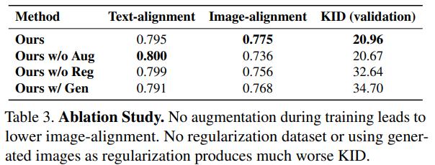
Experiments
KID(Kernel Inception Distance)는 MMD(Maximum Mean Discrepancy)를 feature space에서 진행하는 것을 의미합니다.
간단하게는 실제 이미지와 가짜 이미지 , 실제 이미지와 가짜 이미지의 세트 간의 similarity를 보는 방법이라고 볼 수 있습니다.
Ablation and Applications
Generated images as regularization (Ours w/ Gen): Similar performance on target concept, signs of overfitting (Table 3).
Without regularization dataset (Ours w/o Reg): Slightly lower image-alignment, tendency to forget existing concepts (Table 3).
Without data augmentation (Ours w/o Aug): Lower visual similarity with target images (Table 3).
Fine-tuning on a style: Works with specific styles, e.g., "A painting in the style of V∗ art.“
Image editing with fine-tuned models: Compatible with existing image-editing methods, e.g., Prompt-to-prompt.
Notes:
Generated images as regularization (Ours w/ Gen). As detailed in Section 3.1, we retrieve similar category real images and captions to use as regularization during fine-tuning. Another way of creating the regularization dataset is to generate images from the pretrained model [62]. We compare our method with this setup, i.e., for the target concept of a “category” generate images using the prompt, photo of a {category}, and show results in Table 3. Using generated images results in a similar performance on the target concept. However, this shows signs of overfitting, as measured by KID on a validation set of similar category real images.
Without regularization dataset (Ours w/o Reg). We show results when no regularization dataset is used. We train the model for half the number of iterations (the same number of target images seen during training). Table 3 shows that the model has slightly lower image-alignment and tends to forget existing concepts, as evident from high KID on the validation set. Without data augmentation (Ours w/o Aug). As mentioned in Section 3.2, we augment by randomly resizing the target images during training and append size-related prompts (e.g., “very small”) to the text. Here, we show the effect of not using these augmentations. The model is trained for the same number of steps. Table 3 shows that no augmentation leads to lower visual similarity with target images.
Fine-tuning on a style. We show in Figure 9 that our method can also be used for fine-tuning with specific styles. We change the text prompt for target images to A painting in the style of V∗ art [20]. The regularization images are retrieved with captions having high similarity with “art”.
Image editing with fine-tuned models. Similar to the pretrained model, our fine-tuned models can be used by existing image-editing methods. We show an example of using the Prompt-to-prompt [25] method in Figure 10.

Slide 37
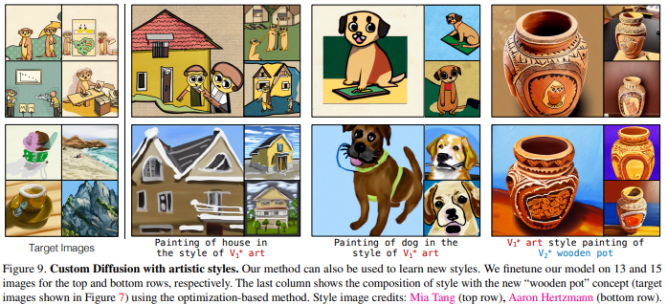
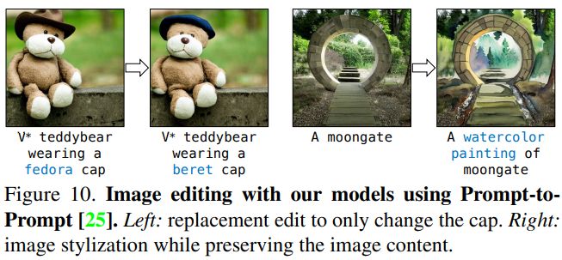
Experiments
Ablation and Applications
Fine-tuning on a style: Works with specific styles, e.g., "A painting in the style of V∗ art.“
Image editing with fine-tuned models: Compatible with existing image-editing methods, e.g., Prompt-to-prompt.

Slide 38
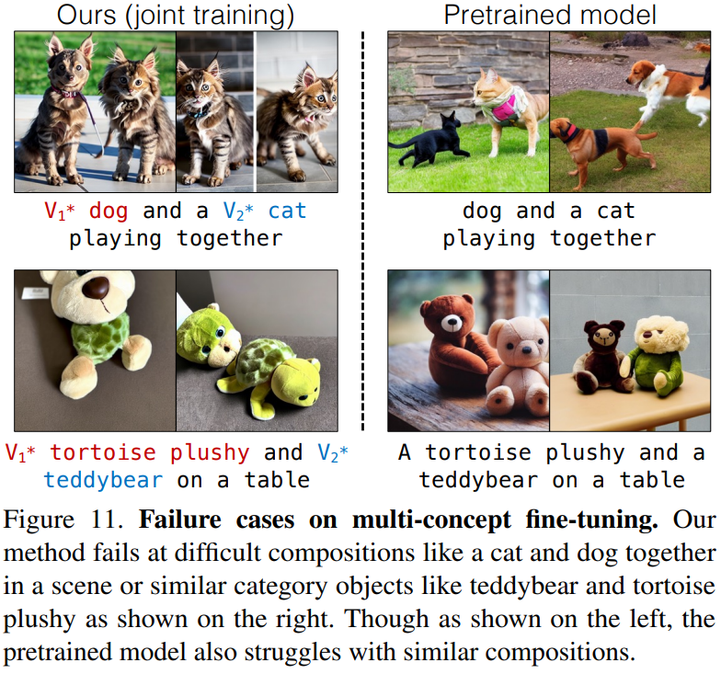
Discussion and Limitations
In conclusion, this study presents:
A method for fine-tuning large-scale text-to-image diffusion models on new concepts, categories, personal objects, or artistic styles with few image examples.
A computationally efficient approach that generates novel variations of fine-tuned concepts while preserving visual similarity with target images.
The need to save only a small subset of model weights.
The ability to coherently compose multiple new concepts in the same scene.
However, challenges remain:
Difficult compositions (e.g., a pet dog and a pet cat) are still problematic.
Composing three or more concepts together is challenging.

Slide 39
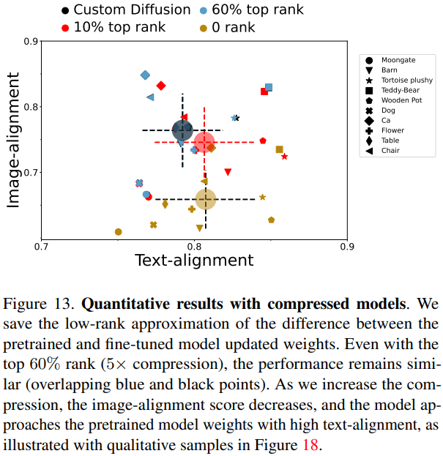
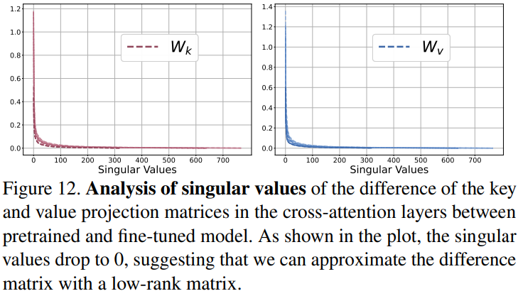
Appendix
Ablation and Applications

Slide 40
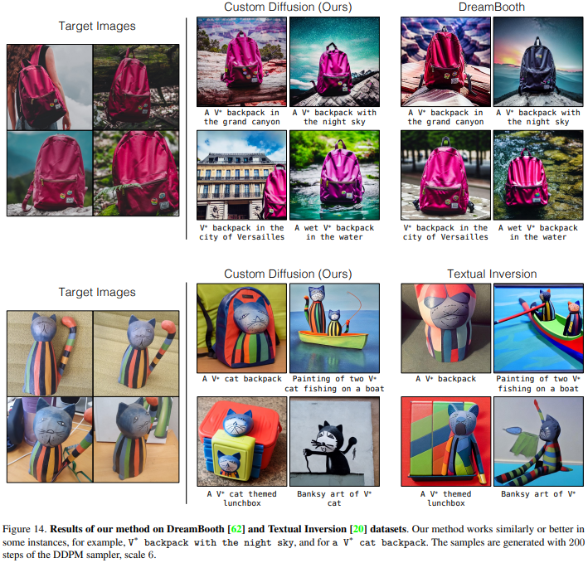
Appendix

Slide 41

Appendix

Slide 42

Appendix

Slide 43
Reference
LoRA: https://www.youtube.com/watch?v=BJqwmDpa0wM

Slide 44



Thank you for your Attention….!

Slide 45

Future Works
https://doooob.tistory.com/700

